Slide 1
The Pyramid Scheme
How EAM and APM Work Together
Rachel Wagner
APM SME / Account Executive
Hexagon
Notes:
Intro:
For organizations that rely on assets to create products, deliver programs, or provide services, Enterprise Asset Management (EAM) is not a tool to do work, but a tool for doing business.
If you're organization wants to protect those assets by containing risk, balancing cost and monitoring performance, Asset Performance Management (APM) is more than anomaly detection, it brings visibility to where it doesn't exist.
Come learn how EAM and APM, when in place and working well, EAM & APM enable organizations to continually compound its collective knowledge of the care, feeding, and performance of assets while helping to continue increase the quality of asset spending decisions.

Slide 2





What do these all have in common?
EAM
+
APM
Notes:
Individually they’re great, but they’re better together.

Slide 3




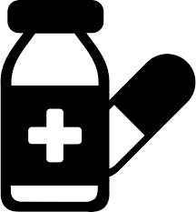
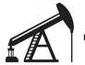
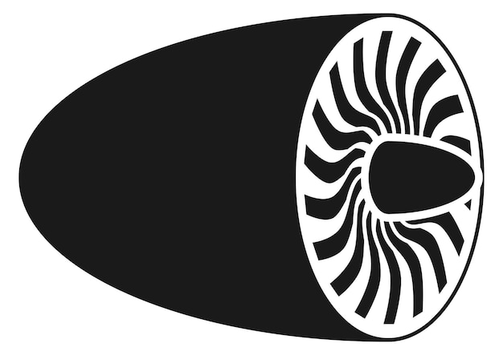

The What
If you rely on assets to create products, deliver programs, or provide services, you need an Asset Management System in place in order to:
1
Keep assets running as expected, at the lowest sustainable cost, while maintaining a tolerable risk level.
2
Have the ability to make high quality decisions to quickly respond, resolve, and remediate any issues that arise.
Notes:
BOTH EAM & APM working together help you achieve this WHAT.
Keep your assets running as expected with no surprises.
Make sound, data-driven decisions about your assets.

Slide 4
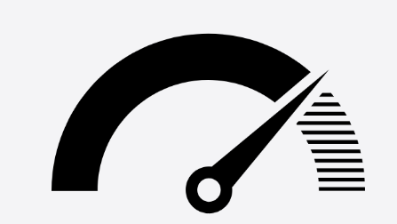
The Why
An Asset Management System helps industrial organizations:
Protect the top line
lower production losses
unlocked capacity to meet demand
Protect the bottom line
less reactive / unplanned maintenance
visibility to actual spend vs. budget
Know your risk exposure
risk is a river; you never step into the same spot twice
Notes:
Why would you invest in a robust asset management system? Simple equation: Less downtime = more production = more revenue;
Less downtime = less money spent on reactive maintenance, expediting inventory, resource OT, etc…. = more money in your pocket.
Manage your costs effectively; think about how much more expensive it is to be highly reactive vs. highly preventive. You’re spending money when you shouldn’t have to be.
And most importantly, organizations should always have line of sight to risk, as it relates to asset management. Do you know how much risk your assets are exposing you to today? Do you have visibility to which assets are performing as expected and which ones are exhibiting behaviors that could lead to an early failure? Do you know which assets are eating up all of your maintenance budget? Can you easily answer the question around repair vs. replace as it relates to O&M spend? Risk is a river; you never step into the same spot twice. It’s always changing, so it’s important to have a system in place to measure and manage it.
Knowing your risk is super important and directly influences how well you’re protecting your revenue and managing your costs. Risk may seem hard to quantify.. but it directly ties to both the top and bottom line. But you don’t have to believe me. Let’s see what Don Shubert from Marsh Insurance has to say about this….

Slide 5


Notes:
Thank you Don. Couldn’t have said it better myself.
Insurance is part of the financial equation for every capital intensive industry. And what is the only thing insurers such as Marsh care about? Risk. Risk to them. They charge you based on how much risk you’re posing to them. There’s a reason your car insurance is so high before the age of 25 or why flood insurance is so high if you live on the west coast of florida. The same risk-based calculations are applied to industrial organizations that operate large capital assets… and insurers will charge based on how well you manage asset risk. So while risk may seem like a qualitative measure, it absolutely is quantitative and directly influences the bottom line.

Slide 6
The How
7
1
What assets do I own and where are they?
2
What are they worth?
STATUS
3
What condition are they in?
4
What do I need to do to improve my assets?
Questions to ask and answer when building an effective Asset Management System
5
When are you going to do it?
EFFORT
6
How much do I need to spend?
7
What does success look like for CI?
SUSTAINMENT
Notes:
So now let’s talk about how we put in place an Asset Management System. There are 7 questions you have to ask yourself when you’re putting in place an AM system. They’re all aimed at protecting your capital investments. Protecting your assets. Keeping them running, keeping them performing. If you can answer these 7 questions with a high degree of confidence, you’ve successfully put in place an asset management system.

Slide 7

The How
7
1
What assets do I own and where are they?
2
What are they worth?
STATUS
3
What condition are they in?
EAM
APM
FOUNDATIONAL
STRATEGIC
4
What do I need to do to improve my assets?
The handoff between EAM and APM happens at the intersection of Questions 3 & 4
5
EFFORT
PRESENT
When are you going to do it?
FUTURE
6
How much do I need to spend?
EFFICIENCY
EFFECTIVENESS
SHOP FLOOR
TOP FLOOR
7
What does success look like for CI?
SUSTAINMENT
Notes:
These questions may seem simple but they’re often not easy to answer… especially at the size and scale of most industrial organizations. Think about the number of assets you have in your EAM registry at a single site… and then multiple that by all of your sites… and then try to put in place strategies for all those assets, and manage those strategies… it’s too much for any person or persons to manage… so we rely on software that can help us answer these questions at speed… and at scale… such as EAM, such as APM. And where is the handoff point between the two softwares? It’s between Q 3 & 4… Information about the status of the asset directly feeds into the effort you’re putting into maintaining those assets, keeping them healthy, making decisions about investments in those assets… EAM and APM shake hands between Q 3 & 4.

Slide 8
What if you can’t answer Questions 1 – 3?

Slide 9
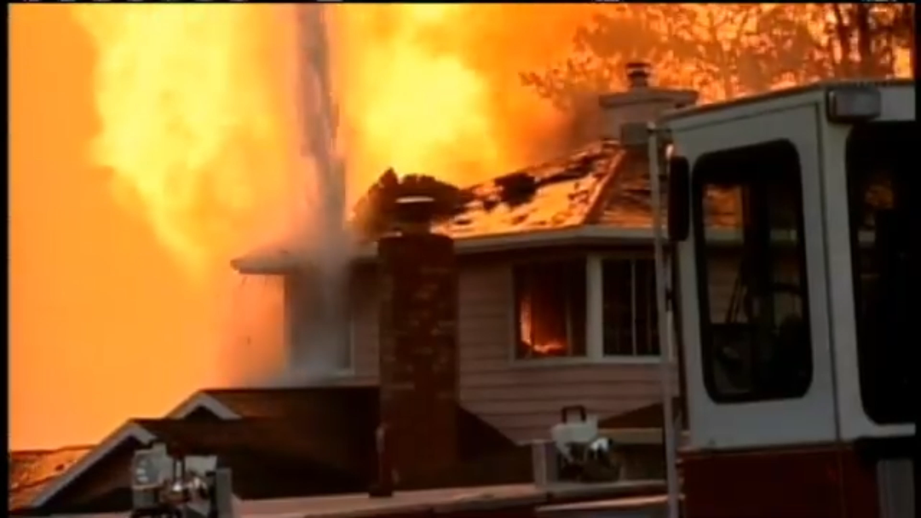

Slide 10
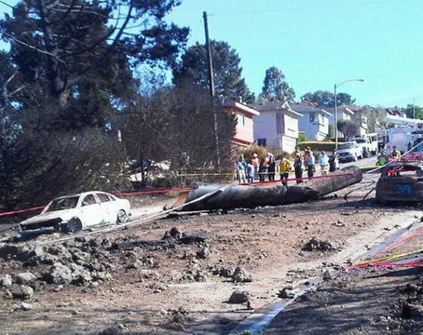
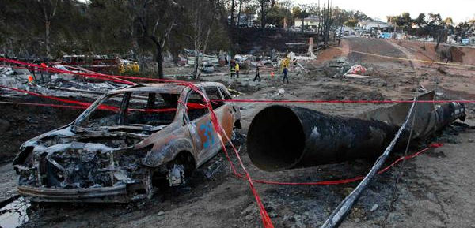
Questions 1 - 3
1
What assets do I own and where are they?
2
What are they worth?
3
What condition are they in?
Draws a boundary around equipment
System of record to document defects
Knowledge transfer of equipment condition
Notes:
You can’t draw a boundary around the equipment and catastrophic outcomes can occur. Wasting resources generating work orders for equipment that can't be found.
Sept 9, 2010: San Bruno. Ca , 30” diameter steel gas pipeline (PG&E) exploded in residential neighborhood 2 miles west of SFO, engineers testified that info about pipeline defects not reflected in company record … devastating event more than 50 homes destroyed, claimed numerous (8) lives, utility couldn't answer 1st 3 questions & consequences dire & devastating.

Slide 11
What if you can’t answer Questions 4 – 6?

Slide 12
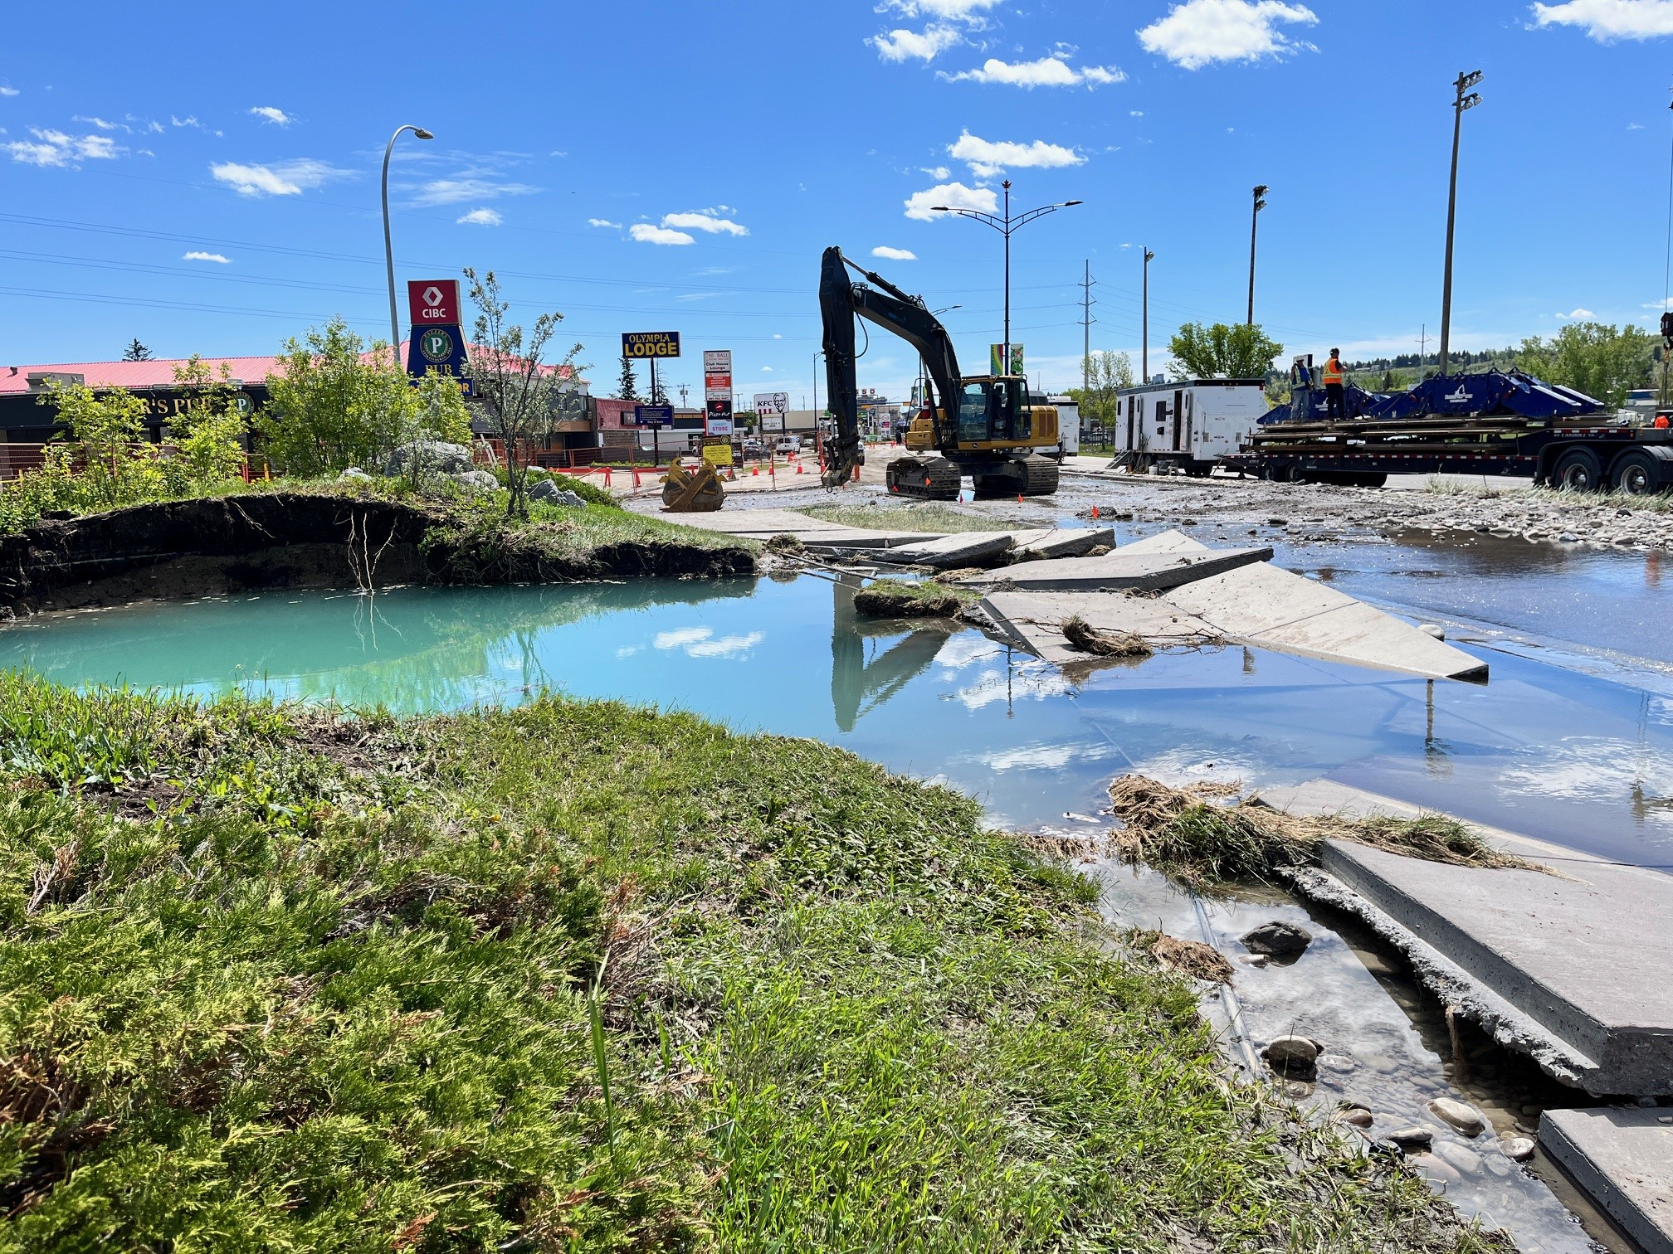
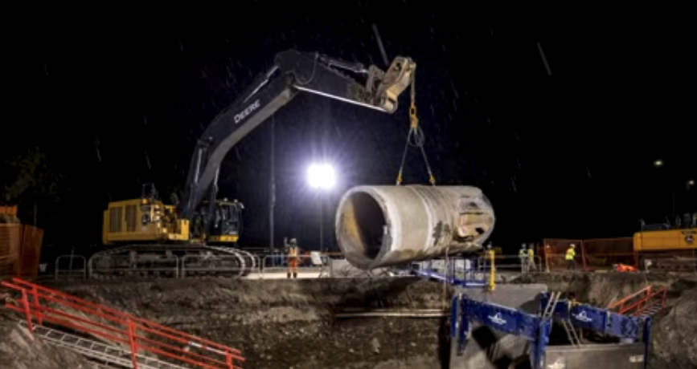
Questions 4 - 6
4
What do I need to do to improve my assets?
5
When are you going to do it?
6
How much do I need to spend?
Know failure modes
Quantify risk exposure
Protect investments
Notes:
June 2023; extreme pipe burst; catastrophic break; Bearspaw South Feeder Main water pipe in Calgary, Alberta burst on June 5, 2023; leaving residents on sever water restrictions for weeks after (corrosion, microcracking); No asset strategy put in place to mitigate risk of failure; Couldn’t answer Q’s 4,5,6
Need to understand failure modes of asset before you can answer questions 4, 5, 6… then you can put in place a strategy that protects your assets against those failure modes with risk exposure quantified and known at all times. As we know – risk is a river; It’s always changing. Your strategy should be dynamic and allow visibility to risk exposure at all times. Otherwise you’re just guessing.

Slide 13
The EAM & APM Handoff
the intersection is at the asset
Enterprise Asset Management
Asset Performance Management
Asset definition + hierarchy + functional location
Asset twin
Asset twin strategy development
Asset twin strategy development
Asset strategy activities defined (i.e. PMs)
Asset twin strategy operationalization
PM execution & compliance
PM compliance & effectiveness
RM/CM execution
RM/CM impact on risk exposure quantified
O&M cost accounting
Actual vs. budget & cost optimization
RCA documentation
Strategy optimization
Notes:
When in place and working well, EAM & APM enable organizations to continually compound the collective knowledge of the care, feeding, and performance of assets while helping to continue increase the quality of asset spending decisions.
So let’s look at these handoff points in a bit more detail…

Slide 14

EAM & APM Decisions
for how best to manage assets
Enterprise Asset Management
Asset Performance Management
What are the things I need to do today to keep my assets running?
How do I my assets performing reliably over their expected lifecycles with no surprises?
How do become the most efficient at performing maintenance?
Is the maintenance I’m doing effective?
Am I compliantly performing my maintenance tasks according to the set schedule?
How do I eliminate maintenance costs without adding undue risk to my operation?
Am I successfully accounting for the costs associated with my maintenance tasks?
If something goes wrong, how do I know what happened and how to fix it quickly?
If something goes wrong, have I documented the root causes and corrective actions?
How do I prevent the problem from happening in the first place?
Notes:
What about questions an organization is looking to answer… how do these stack up

Slide 15


Myth Busters
APM is not:
APM is:
A module within EAM
A tool to help you do reactive maintenance faster
Another system that manages work execution
Only something you use when you’ve reached high maintenance maturity
Only something you use when you have perfect data quality
An extension of EAM information,
bringing visibility to asset performance,
cost, and risk
A system that delivers insights by exception when anomalous behaviors are detected and action is needed
A solution that puts in place a living risk-based asset strategy to help make decisions around how best to manage assets
A solution that brings visibility to data quality gaps and improves overall utilization of EAM
Notes:
I think most people here are very familiar with what EAM does but may not be quite as familiar with what APM does….Now I’ll share a few myth busters about what APM is and what it is not.

Slide 16
PLOT TWIST!

Slide 17
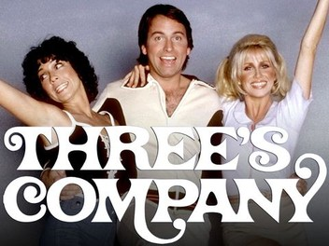
Notes:
Three's Company is an American television sitcom that aired for eight seasons on ABC from March 15, 1977, to September 18, 1984:
About three single roommates: Jack Tripper, Janet Wood, and Chrissy Snow, who all platonically live together in a Santa Monica, California

Slide 18
The Asset Management System
Meaningfully supported by 3 business solutions:
EAM
APM
AIP
Enterprise Asset Management
Asset Performance Management
Asset Investment Planning
Notes:
Again – the goal here is putting in place an asset management system… software is only as important as the value it provides… so let’s talk about how EAM, APM, and AIP fit into the AM system to provide meaningful value to organizations

Slide 19
The Pyramid Scheme

Slide 20
Asset Management System
a value chain model
Keep stakeholders happy
Org
management
Portfolio ROI, Compliance, Sustainability
Manage asset portfolio
System performance,
cost, risk control
Manage asset systems
Lifecycle activities, Efficiency & Effectiveness
Manage individual assets over their lifecycles
Notes:
Let’s think of an AM system as a value chain model. At the foundation of this pyramid, we’re interested in how best to manage individual assets over their lifecycles. What are my PMs. How do I efficiently plan schedule & execute work. How do I track all of my WOs, plan manpower, manage spare parts inventory.

Slide 21
Asset Management System
a value chain model
STRATEGIC
FUTURE
EFFECTIVENESS
Org
management
TOP FLOOR
Manage asset portfolio
Manage asset systems
SHOP FLOOR
EFFICIENCY
Manage individual assets over their lifecycles
PRESENT
FOUNDATIONAL
Notes:
Foundational – strategic
Present – future
Efficiency -- effectiveness
Shop floor – top floor

Slide 22
Asset Management System
a value chain model
STRATEGIC
FUTURE
CPM
EFFECTIVENESS
TOP FLOOR
AIP
OP RISK
ASSET RISK
AI/ML
PATTERN PROTECTIONS
ADVISORIES
DIGITAL TWIN
ASSET STRATEGIES
CONDITION MONITORING
RCFA
CRITICAL SPARES
PREDICTIVE MAINTENANCE
SHOP FLOOR
EFFICIENCY
ASSET DATABASE
OPERATOR ROUNDS
MATERIALS MGMT
PRESENT
WORK PLANNING
WORK EXECUTION
WO SETTLEMENT
PMs
FOUNDATIONAL
Notes:
Foundational – strategic
Present – future
Efficiency -- effectiveness
Shop floor – top floor

Slide 23
Asset Management System
a value chain model
STRATEGIC
FUTURE
CPM
ASSET INVESTMENT PLANNING
EFFECTIVENESS
TOP FLOOR
AIP
OP RISK
ASSET RISK
AI/ML
PATTERN PROTECTIONS
ADVISORIES
DIGITAL TWIN
ASSET PERFORMANCE MANAGEMENT
ASSET STRATEGIES
CONDITION MONITORING
RCFA
CRITICAL SPARES
PREDICTIVE MAINTENANCE
SHOP FLOOR
EFFICIENCY
ASSET DATABASE
OPERATOR ROUNDS
MATERIALS MGMT
ENTERPRISE ASSET MANAGEMENT
PRESENT
WORK PLANNING
WORK EXECUTION
WO SETTLEMENT
PMs
FOUNDATIONAL
Notes:
How is the AM system supported...AIP + APM + EAM

Slide 24
Asset Management System
a value chain model
4
1
7
What do I need to do to improve my assets?
What does success look like for CI?
What assets do I own and where are they?
CPM
ASSET INVESTMENT PLANNING
5
2
What are they worth?
When are you going to do it?
AIP
OP RISK
3
6
What condition are they in?
How much do I need to spend?
ASSET RISK
AI/ML
PATTERN PROTECTIONS
ADVISORIES
DIGITAL TWIN
ASSET PERFORMANCE MANAGEMENT
ASSET STRATEGIES
CONDITION MONITORING
RCCA
CRITICAL SPARES
PREDICTIVE MAINTENANCE
ASSET DATABASE
OPERATOR ROUNDS
MATERIALS MGMT
ENTERPRISE ASSET MANAGEMENT
WORK PLANNING
WORK EXECUTION
WO SETTLEMENT
PMs

Slide 25

If you want to go fast, go alone.
If you want to go far, go together.
-- African Proverb
(also featured in Mufasa)

Slide 26
