Slide 1

Maintenance Asset Health Index
Rene J. Nazario-Diaz
CEO

Slide 2

Maintenance Asset Health Index

Slide 3


Challenge: Making the connection
Asset Health?
Asset Risk?
Vital Signs
Maintenance Transactional Data

Slide 4
Use what we have at hand
Work Orders
Overhauls
Asset Criticality
Asset Condition Assessments
PM/CM History
MRO Usage/ Inventory
Notes:
MAHI by Sub-system detail is a combination of:
Asset Condition
WO Split
Overhaul
Inventory Compliance
PM Compliance
WO Priority

Slide 5
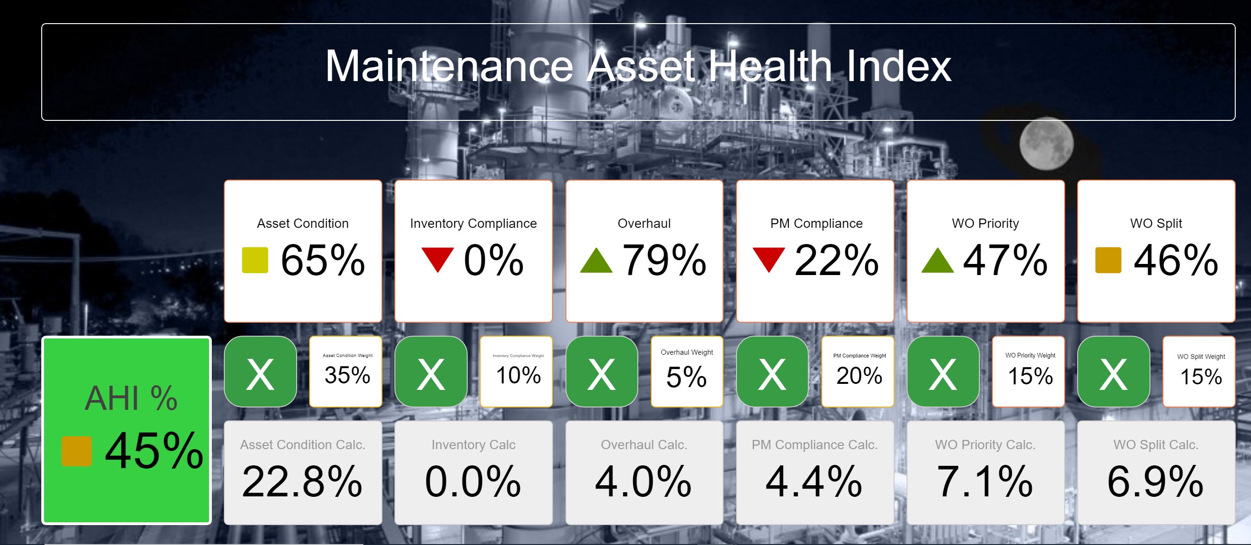
Use what we have at hand
Notes:
MAHI by Sub-system detail is a combination of:
Asset Condition
WO Split
Overhaul
Inventory Compliance
PM Compliance
WO Priority

Slide 6


MAHI for Combined-cycle gas-fired Power Plant (Steam Turbine)
HRSG AHI
Steam Turbine AHI
Generator AHI
Transformer AHI
Control AHI
BOP AHI

Slide 7
Maintenance Asset Health Index
$$\left.MAH Index =f(Probability, PM Compliance,\frac{Preventive}{Corrective},WO Priority,Asset Condition,Critical Spares \right)$$
Probability – How much time left before the next major overhaul? How much risk?
PM Compliance – Are we keeping up with our PM Program? Generate all WO’s. Complete all WO’s (on-time)
WO Split (Preventive/Corrective) – How effective is my PM Program? If we’re doing our PM’s right, we should have fewer corrective actions.
WO Priority – Are we taking care of the highest priority Work?
Asset Condition – What is the condition of the asset according to the people on the field?
Critical Spares – Do I have the right spares in the right quantities when needed?

Slide 8
Maintenance Asset Health Index
$$\left.MAH Index =f(Probability, PM Compliance,\frac{Preventive}{Corrective},WO Priority,Asset Condition,Critical Spares \right)$$
Probability, Risk, Time
Gas turbine overhaul
Gas turbine
24/36 = 66%
Feb 2020 (24 months)
months
months
Last Major Overhaul
Next Major Overhaul
Feb 2018
Feb 2021
(36 months)

Slide 9

Maintenance Asset Health Index
$$\left.MAH Index =f(Probability, PM Compliance,\frac{Preventive}{Corrective},WO Priority,Asset Condition,Critical Spares \right)$$
Preventive Maintenance (PM) Schedule Compliance
PM Schedule
WO Generated
WO Closed (on-time)
Scheduled End Date = Actual End Date (HIT)
$$\frac{Total Number of Hits}{Total PM WO^{′}s}$$
months
Last Major Overhaul
Next Major Overhaul

Slide 10

Maintenance Asset Health Index
$$\left.MAH Index =f(Probability, PM Compliance,\frac{Preventive}{Corrective},WO Priority,Asset Condition,Critical Spares \right)$$
Work Order Split
Corrective WO’s
$$\frac{Total Number of PM WO^{′}s}{Total PM WO^{′}s+Corrective WO^{′}s}$$
Preventive WO’s
months
Last Major Overhaul
Next Major Overhaul

Slide 11

Maintenance Asset Health Index
$$\left.MAH Index =f(Probability, PM Compliance,\frac{Preventive}{Corrective},WO Priority,Asset Condition,Critical Spares \right)$$
Work Order Priority = Asset Criticality * WO Impact * WO Age
Urgent WO’s
Priority 1
$$\frac{Total Number of closed Urgent+P1 WO^{′}s}{Total WO^{′}s}$$
Priority 2
Priority 3
months
Last Major Overhaul
Next Major Overhaul

Slide 12
Maintenance Asset Health Index
$$\left.MAH Index =f(Probability, PM Compliance,\frac{Preventive}{Corrective},WO Priority,Asset Condition,Critical Spares \right)$$
Criticality Code | Description
1 | Does NOT affect Operation
2 | NON-Essential to Operation - Backup Available
3 | NON-Essential to Operation - No Backup Available
4 | Essential to Operation - Backup Available
5 | Essential to Operation - No Backup Available
6 | Essential to SAFETY
WO Impact | Description
1 | Routine Checks and less important tests
2 | Operational test/Performance verification
3 | Preventative Maintenance/Inspection
4 | To improve performance and/or reliability
5 | Defect affects performance of main Equipment
6 | Fault Caused an OUTAGE, Elimination necessary
7 | Fault Endangers Vital Equipment
8 | Elimination of Fault is indispensable to SAFETY
Work Order Age (days) | Work Order Age (weeks) | Weight
0-14 | 1-2 | 1
15-30 | 3-4 | 2
31-45 | 5-7 | 3
46-60 | 8-9 | 4
61+ | 10+ | 5
Age Factor

Slide 13
Maintenance Asset Health Index
$$\left.MAH Index =f(Probability, PM Compliance,\frac{Preventive}{Corrective},WO Priority,Asset Condition,Critical Spares \right)$$
Calculated Priority = Asset Criticality Factor * WO Impact Factor * Age Factor
If Calculated Priority is between 1 and 9, then Priority = "Priority3"
If Calculated Priority is between 10 and 18, then Priority = "Priority2"
If Calculated Priority is between 19 and 29, then Priority = "Priority1"
If Calculated Priority is Greater than 30, then Priority = "Urgent"

Slide 14
Maintenance Asset Health Index
$$\left.MAH Index =f(Probability, PM Compliance,\frac{Preventive}{Corrective},WO Priority,Asset Condition,Critical Spares \right)$$
Age Weight factor = 1
Age Weight factor = 3
Age Weight factor = 2
Age Weight factor = 4

Slide 15

Maintenance Asset Health Index
$$\left.MAH Index =f(Probability, PM Compliance,\frac{Preventive}{Corrective},WO Priority,Asset Condition,Critical Spares \right)$$
Asset condition (snapshot)
Unit 1
Asset
Criticality
Gas Turbine
Condition = Poor
1st Stage
Blades
Critical, Poor
Work Order
Condition Assessment
2nd Stage
Critical Condition Index - Worst case scenario, based on the most critical asset in the system (Ex. If most critical asset in the system is a 6 then Max Poor Condition Factor = 30).
Blades
Critical, Good
Critical Condition Score - CONDITION X CRITICALITY - for each of the assets in the subsystem.
$1 −(\frac{Critical Condition Score}{Critical Condition Index}$) x100

Slide 16
Maintenance Asset Health Index
$$\left.MAH Index =f(Probability, PM Compliance,\frac{Preventive}{Corrective},WO Priority,Asset Condition,Critical Spares \right)$$
Code | Condition | Comments
1 | Very Good | Only normal maintenance required
2 | Minor Defect only | Minor maintenance required
3 | Maintenance Required to return to accepted level | Significant maintenance required
4 | Required renewal | Significant renewal/upgrade required
5 | Unserviceable | asset requires replacement
0 | To be evaluated | If an asset has not been serviced in the number of months, defined for its class, the condition will be set to 0 automatically. The condition index will be an average of the work orders at closing. The original asset load will have all assets, set to Condition 0.

Slide 17
Maintenance Asset Health Index
$$\left.MAH Index =f(Probability, PM Compliance,\frac{Preventive}{Corrective},WO Priority,Asset Condition,Critical Spares \right)$$
Critical Spares (snapshot)
Asset
Critical Spares
Critical Spares = 50%
Part ID | Quantity Required | Current Stock Level | Compliant (Hit/Miss)
ABC123 | 2 | 0 | 0 (miss)
XYZ456 | 4 | 10 | 1 (hit)

Slide 18
Maintenance Asset Health Index
$$\left.MAH Index =f(Probability, PM Compliance,\frac{Preventive}{Corrective},WO Priority,Asset Condition,Critical Spares \right)$$
Here’s a little math…..
 | Probability (time consumed) | PM Compliance | WO Split | WO Priority | Asset Condition | Critical Spares | Asset Health Index (AHI)
Score | 20% | 95% | 84% | 95% | 100% | 95%
Weight | 5% | 20% | 15% | 15% | 35% | 10%
Rating | 1% | 19% | 12.54% | 14.25% | 35% | 9.50% | 91%
Rating = Score X Weight
Σ Ratings = AHI

Slide 19
Maintenance Asset Health Index
$$\left.MAH Index =f(Probability, PM Compliance,\frac{Preventive}{Corrective},WO Priority,Asset Condition,Critical Spares \right)$$

Slide 20
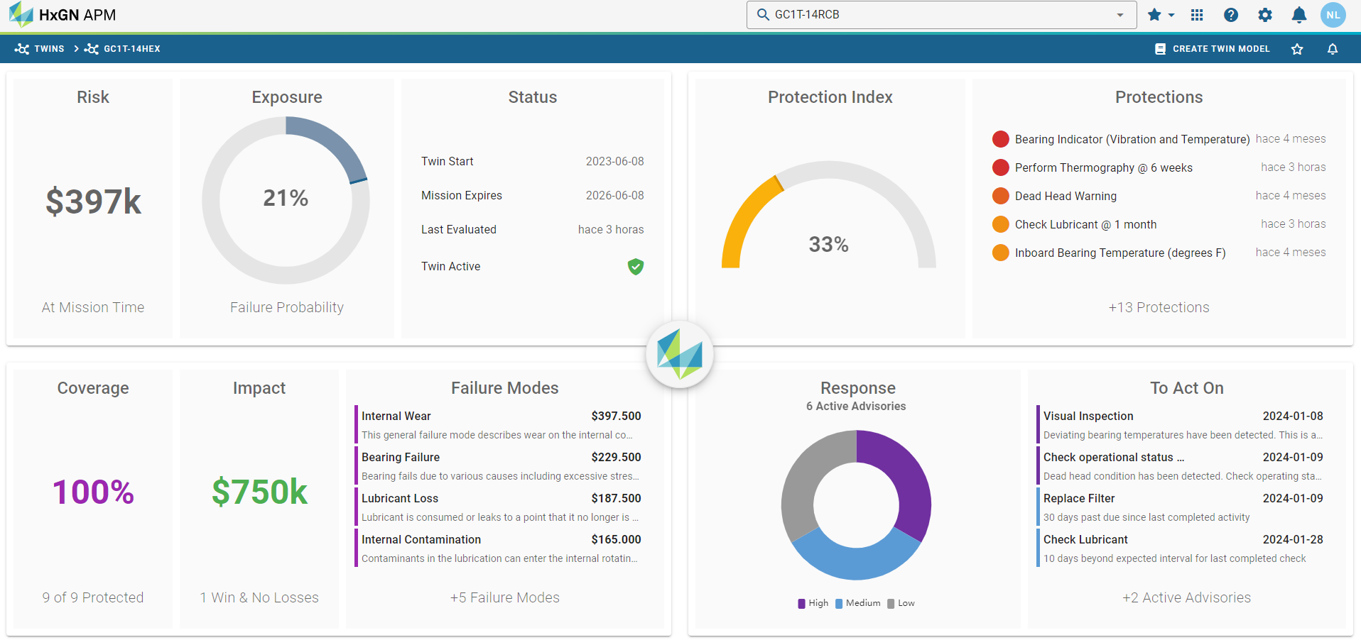
MAHI for predictive maintenance?

Slide 21
MAHI for predictive maintenance?
Initial Inspections and AHI Calculation. Field crews inspect poles and EAM calculates AHI score. Assets are categorized into different health zones (Good, Fair, Poor).
Tracking and Analyzing AHI Trends Over Time. AHI scores are logged monthly/annually, identifying trends of deterioration. A pole with an AHI score declining from 4.5 to 3.2 in two years indicates a potential failure in the near future.
Apply Predictive Analytics. Predictive algorithms analyze AHI trends along with environmental and operational data. A maintenance schedule is adjusted based on projected failure risks
Preventive and Predictive Actions. Field crews focus efforts on assets showing the steepest decline in AHI scores. Assets are proactively replaced or rehabilitated before failure occurs.
Prioritize Maintenance: Focus on assets with rapidly declining AHI scores

Slide 22


Puerto Rico
October 15th & 16th, 2025
More information coming soon! karla.cruz@visualk.com

Slide 23
Maintenance Asset Health Index
Rene J. Nazario-Diaz
CEO

