Slide 1
Storeroom Secrets How MRO Drives Profitability & Performance
Peyton Griggers
Executive Industry Consultant
Hexagon

Slide 2
Key Components & Takeaways
1
Establish The Foundation – See The Big Picture
2
Build the Team – Establish Ownership & Empower Personnel
3
Be Introspective – Know Where You Are & Where You are Going
Topic 3
4
Define Success – Implement Processes & Systems
5
Measure Performance & Drive Continuous Improvement
6
Communicate Success & Progress – Build Case Studies & Reward Performance

Slide 3
Find Your Why: Why Is MRO Important??
MRO Is Rarely Identified As A Key Strategic Opportunity To Improve Performance & Margin
A typical MRO storeroom with high excess stock has an average inventory value of $15 million dollars
Excess carrying costs for a $15 million dollar storeroom has around $2 million in avoidable expenses
A company with 10,000 MRO POs / year spends up to $2 - $4 million in purchasing costs
A $15 million dollar Inventory with 90% accuracy means there is $1.5 million in “Missing Stock”
Every 1% reduction in stockout rate can literally save millions in downtime & emergency orders
3 % inventory shrinkage for a $15 million dollar storeroom is $450K in annual lost inventory
Numbers are based on a $500 Millon Dollar Annual Revenue Organization

Slide 4
Asset Lifecycle Management Process
1
Secret #1: MRO Is A Critical Component of the Asset Lifecycle Management Process
Maintenance/Reliability Strategy
Planning &
Scheduling
Execution
CMMS / EAM
Asset Registry & Hierarchy
P&ID / Asset docs
Planned
Corrective
Maintenance
Unplanned
Corrective
Maintenance
Labor
Parts, Tools
Remarks
Financial system
Asset
Management
Organization
Asset Criticality
MAINTENANCE
STRATEGY
Preventive Maintenance
Optimization / Development
Planning
and
Scheduling
Work
Execution
Asset
Safety
Process
Spare Parts Strategy
FMEA/FMECA
• Master Item Register
• Commodity groups
• Critical spares
Asset
Management
Software
High Criticality
MTA
• Optimized Workflow
• Maintenance safety
procedures
Medium Criticality
RTF
Design
For
Reliability
Low Criticality
• Optimized PM plans
• Condition monitoring program
• Calibration plans
• Autonomous maintenance
(TPM pillar)
• Maintenance training program
• Operators’ training program
Economic-safety-based decision
Reliability Engineering
Analysis
Update
Analyze
*SEAM Group Reliability Loop

Slide 5
Typical MRO Storeroom Criticisms & Frustrations
The Common Obstacles to Storeroom Optimization
What I Need!
When I Need It!
Where It Is Supposed To Be
It seems I can never find
Identifying parts is difficult and the data is all over the place.
Maintenance technicians spend to much time chasing correct parts
My storeroom should house all items needed at all times
It’s easier to order parts directly than trying to find them
Expedite, Expedite, Expedite
We use that part all of the time so how can we be out of them?
It says it’s in the bin, but it’s nowhere to be found
We have so much stuff (from 1985)
The system information is always wrong!

Slide 6
Establish The Key Contributors & Stakeholders
2
Secret #2: It’s Not Just A Storeroom Clerk
Supervisor / Technician
Availability / Pick-up / Returns / Process Adherence
Plant Manager
Strategic Direction / Leadership / Budgeting
Storeroom Manager
Design / Efficiency / Training / Analytics
Storeroom Clerk
Issues / Receipts / Requisitions / Kitting / Staging / Storeroom Controls
Purchasing Agent
Procurement / Price Optimization / Enterprise Planning
Reliability Engineer
Bills Of Materials / Critical Spares
Maintenance Planner
Parts Requirements / Forecasting

Slide 7
Develop A Strategic Mindset
3
Secret #3: Drive Success By Looking Beyond The Physical Storeroom
Success is the result of perfection, hard work, learning from failure, loyalty, and persistence
- Colin Powell
Establishing Governance & Ownership
Commitment to Excellence
Defining objectives
Understanding stakeholders and driving collaboration (RACI)
Committing financially to achieve objectives
Holding everyone accountable
Analytically monitoring progress & status
Celebrate Victories
Reward Success
Drive continuous improvement
Success is the result of commitment, investment, and an individual & collaborative demand to settle for nothing less than achieving your objectives.
- Peyton Griggers

Slide 8
Look Beyond The Surface
4
Secret #4: Analyze The Symptoms To Find Underlying Systemic Causes
Surface Level Issues
Root Causes
Poor Data & Control
Stock Levels
Reorder Levels
Min / Max
Critical Spare ID
Poor Inventory Missing Stock / Stock Outs
Inventory Accuracy
Process
Storeroom Access & Procedures
Data Quality
Duplication, Incorrect levels, Missing Specs
Process Control
Clutter / Mixed Parts / Disappearing Stock / Expired Material
Issue Process
Part / Work Order Association
Excess Stock
Obsolete Material / Overstocking
Part Association
Bill of Material Management
Cost Management
Inter Department Support
Parts Not Associated To Assets / Lack of Critical Spares
Location Control
Por Part movement / Returns / Staging

Slide 9
Identify Industry Specific Challenges
5
Secret #5: Determine Unique Organizational MRO Needs & Process Development Requirements
Field Level Support
Telecom
T&D
Mobile & Distributed Assets
Fleet Management
EV Charging Stations
Offshore & Remote Locations
Offshore
Shipping / Vessel Management
Oil & Gas
Pipelines
Remote Access Facilities
Mobile Service Providers
Manufacturing & Process
Pharma
Food & Bev
Chemical Production
Discrete Mfg.
CPG
Automotive

Slide 10
Establish The Goals
6
Secret #6: Determine the Ingredients For Success
Enterprise Cost Optimization
Optimized Process Controls
Kitting & Staging Optimization
EOQ Analysis
Storeroom Design
Governance
ABC Analysis
Standardized Data
Bi-Asset Material Controls
Inventory Valuation
Personnel & SME Optimization

Slide 11
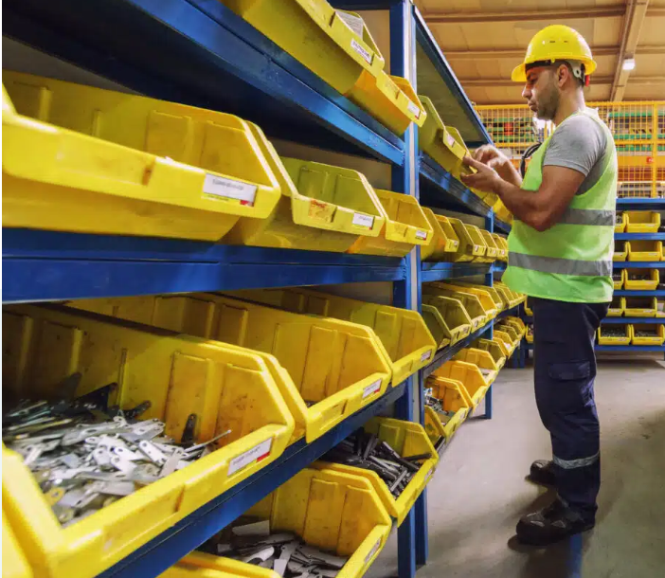
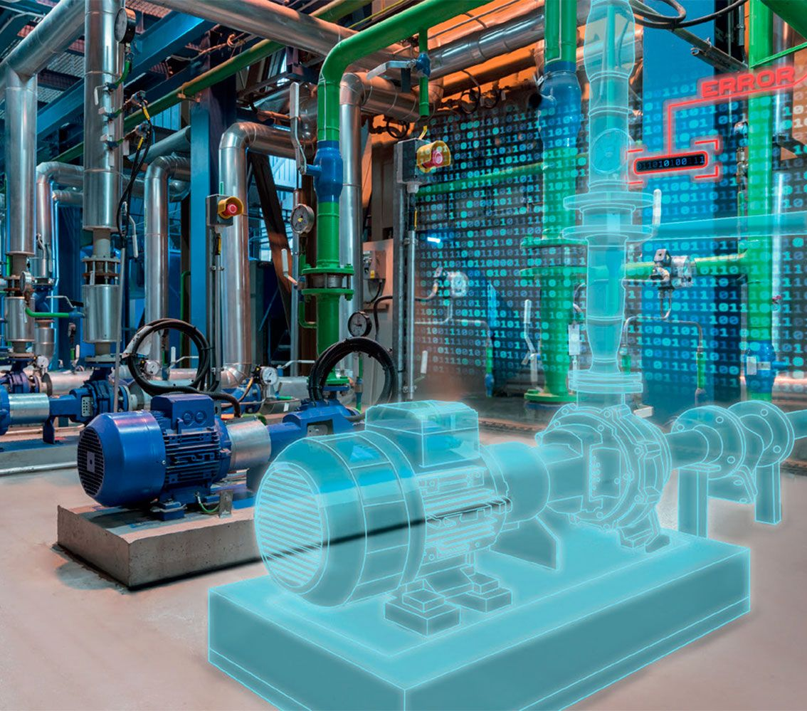
Data Standardization
7
Secret #7: Your Data Is The Secret Sauce
Data is NOT just part descriptions!! All the components must be in place to provide accurate analytics and measure performance.
MRO data drives efficiency, reduces downtime, and allows informed decisions
Data standardization is crucial to achieving optimized stock and financials
MRO spending can reach 20% or more of plant budgets.
Dashboard analytics provide valuable inventory flow statistics
Enterprise-level data standardization allows insights into cost controls, part sharing, continuous improvement, and leveraging vendor contracts
Asset BOMs and critical spare data drive efficiency and reduces inventory

Slide 12
MRO Storeroom Management Framework
8
Secret #8: Define Your Process, Policy, & Execution Procedures
An MRO Storeroom is like a bank! Processes must be implemented to maintain controls, costs, and traceability Anything that enters, leaves, or transfers MUST have a transaction Almost all issues with Inventory Accuracy can be traced to transaction process failure or a lack of communication with reliability and maintenance teams
Process
Configuration
Communication
1
2
3
Receipts
Reservations
Issues
Transfers
Returns
Damage
Requisitions
Kitting
Obsolescence
Storeroom Layout
Location Design
Bin Configuration
Labeling / Barcoding
Storage
Staging
Equip Changes
Parts Needed
Schedule Changes
Shutdown Management
Part Changes
Delivery Data
Lead Times
The Average MRO Storeroom Value For A $500M Company Is $10 Million Dollars

Slide 13
Storeroom Operations
8
Business Process Engineering To Facilitate Operational Excellence
Process
Personnel & Communication
Configuration - Physical Storeroom
Storeroom Staffing
Location Identification, Naming, & Management
Receiving, Stocking, Kitting, Notification & Delivery Procedures
Stock Management – Issue, Return, Stock Outs
Personnel & Backup Resource Training
Roles, Responsibilities, & Communications Protocols
Aisle & Shelve Strategy, Part & Bin Labeling / Barcoding
Security & Access Controls
Physical Inventory & Spare Part Maintenance (Stock Level Management)
A $10M Inventory With 90% Accuracy Means $1M in Missing Stock!

Slide 14
Define A Stocking Strategy
8
Critical Components
Bills Of Materials
Critical Spare ID
Part Classification
Replenishment
Purchasing History
Min / Max Approach
Cost Optimization
EOQ Analysis
Stock Optimization
Asset Commissioning
Storeroom Locations
ABC Analysis
Part Obsolescence
Safety Stock
Repairable Spares
Vendor Managed Stock
Shared Stock
Supplier Management
Lead Times
Stock / Non-Stock Strategy
Identify Priority Stock & Optimize Financial Investments

Slide 15
Measure Success
9
Secret #9: Establish The Business Value & Measure Results
Identifying Lost Revenue To Establish Business Value & ROI
Metric | Typical Percentage Range | Example ($500M Annual Revenue Facility) | Comments
Inventory Stock-Outs Production Costs | 3 – 10 | 15M - 50M | Driven by poor safety stocking, controls, and forecasting
Excessive Stock | 5 – 20 | 0.5M – 2M | MRO Value is typically 1% - 3% of annual revenue (2% used for calculations)
Maintenance Labor Hours (Wrench-Time) Lost Due to Stock-Outs | 6 - 15 | 1.8M – 4.5M | Average wrench-time is 25%-40%. Average maintenance spend is 3% – 10% of revenue (6% used for calculations)
Emergency Orders | 10 – 30 | 0.84M – 2.5M | Cost 20-50% more than planned orders. Average normal order cost is $200-$400 and MRO orders are between 10,000 – 50,000 (35% Cost add, $250 order cost and 25,000 orders used for calculations)

Slide 16
Measure Success
9
Define KPIs, Dashboards, & Analytics To Measure Progress
Stock Value As A % of RAV (1-3%)
Inventory Turnover (1-3)
Stock Accuracy (95-99%)
Inventory Service Level (95-98%)
Stock Outs (2-5%)
Inventory Shrinkage (1-3%)
Slow Moving Items (3-5%)
Parts Issued To A WO (95%)
Items Received
Items Issued
New Items Added
# Storeroom Transactions
Total Inventory Value

Slide 17
This food and beverage organization needed improvement in OEE and determined that a large contributor was lack of control over their MRO processes.
MRO Storeroom Optimization Case Study
10
Secret #10: The Proof Is In The Pudding
Customer Goals: | Solution: | Winning Results:
Improve inventory accuracy. Implement & train on best practices Implement cycle count program and transaction controls Improve cost tracking to maintain equipment. Improve procedures and provide training on the CMMS system usage Improve communication between Maintenance Planning & Schedule, Stores, and Purchasing. Establish Metrics and KPIs to track progress. Redesign storerooms and locations to better track and manage parts. | Conducted a detailed assessment to identify root causes of current issues. Formulated standard operation procedures and work checklists for processes that involved parts, ensuring a comprehensive approach to optimizing performance and operational readiness. Establish governance program for CMMS and MRO activities Redesigned and implemented improved storeroom configuration, bin configuration, and part distribution processes. Performed full cycle counts and stock identification / relocation effort throughout the facility | Over $1.2mm in stray parts that were located, identified, and added into the storeroom and into the CMMS. Implemented best practices in data management and transaction process that reduced part related downtime by 30% Implement best practice SOPs on all the Storeroom operations & transactions. Developed new personnel configuration with specific training on MRO process and practices. Established KPIs and controls resulting in inventory accuracy improvement from 45.3% to 98.2%. Six months later the accuracy continues to be between 98-99% Implemented communication processes between MRO storerooms, maintenance, and purchasing.

Slide 18
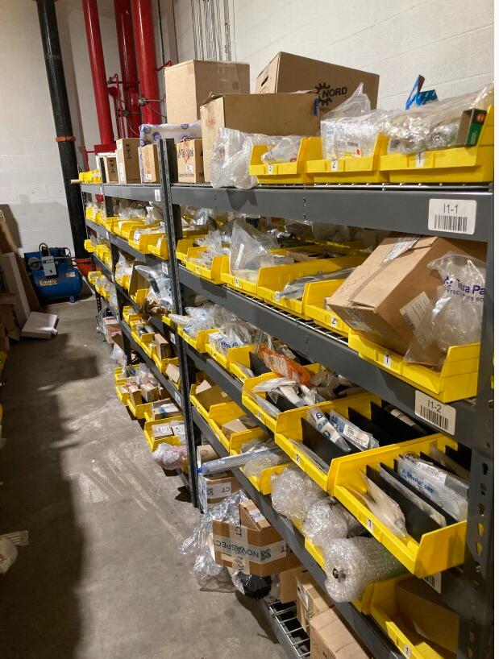
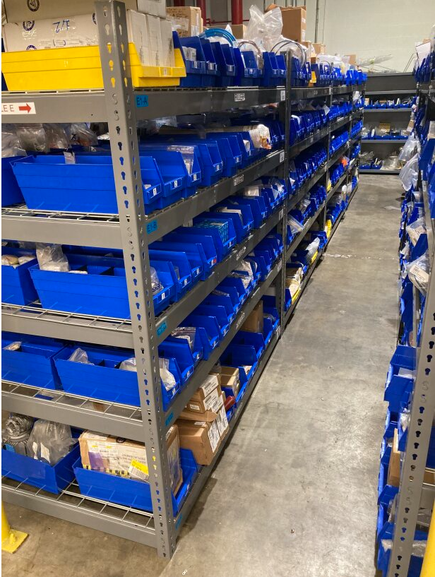
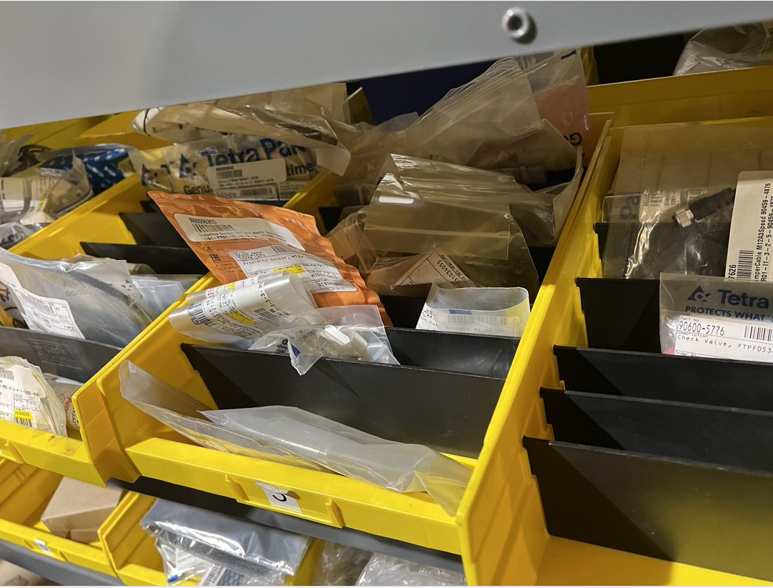
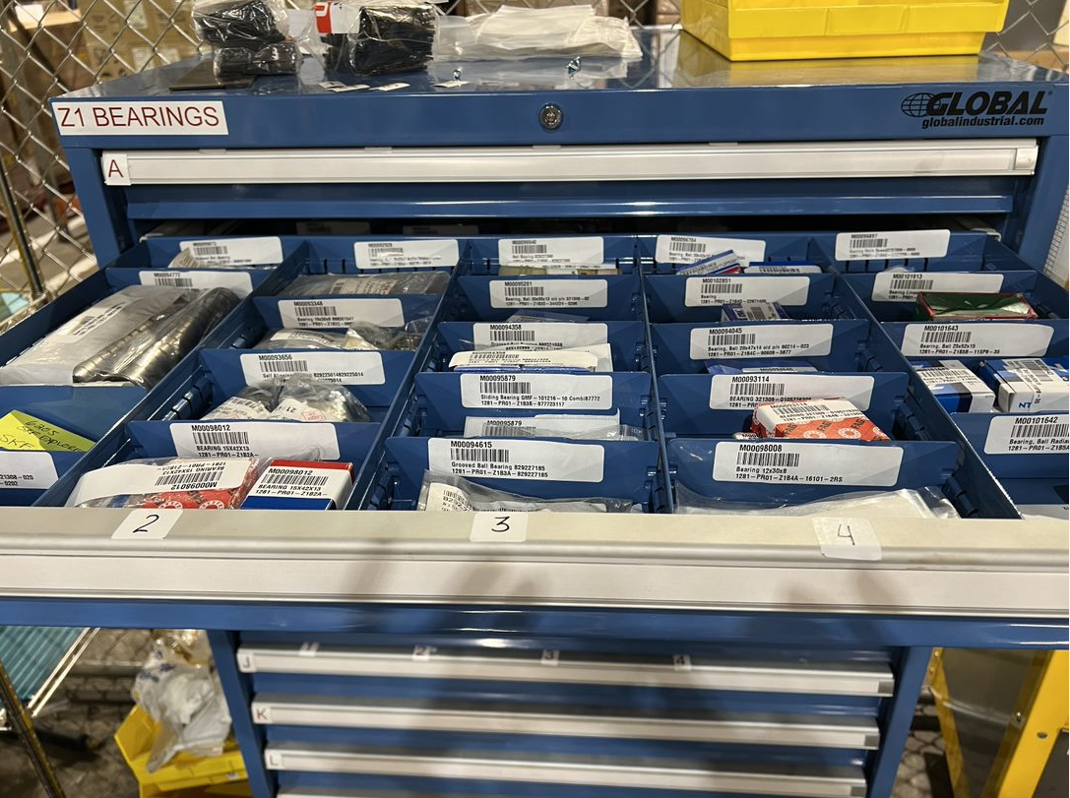
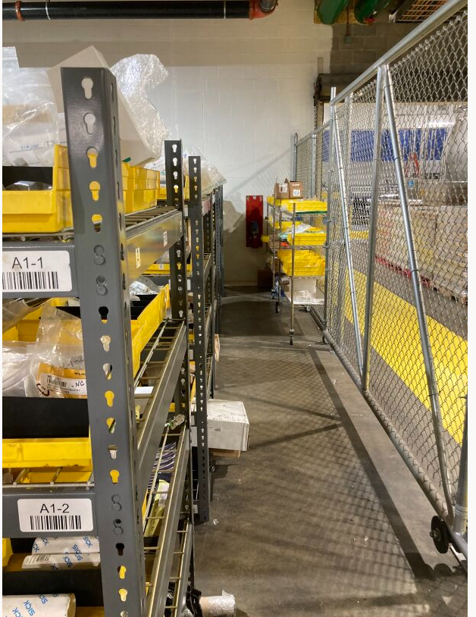
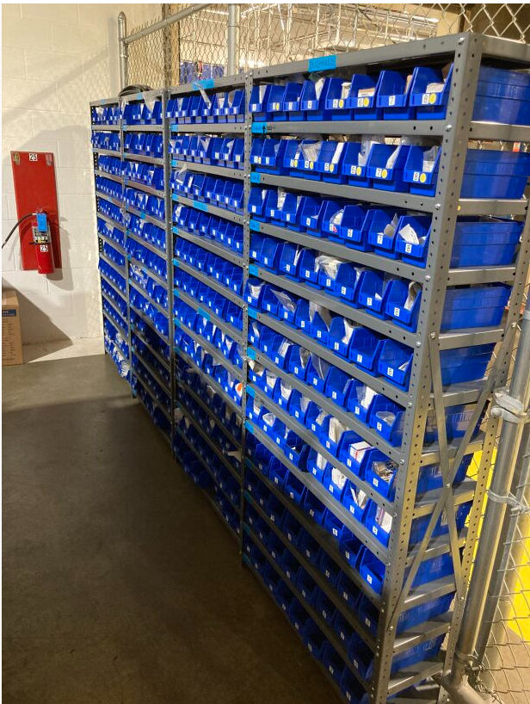
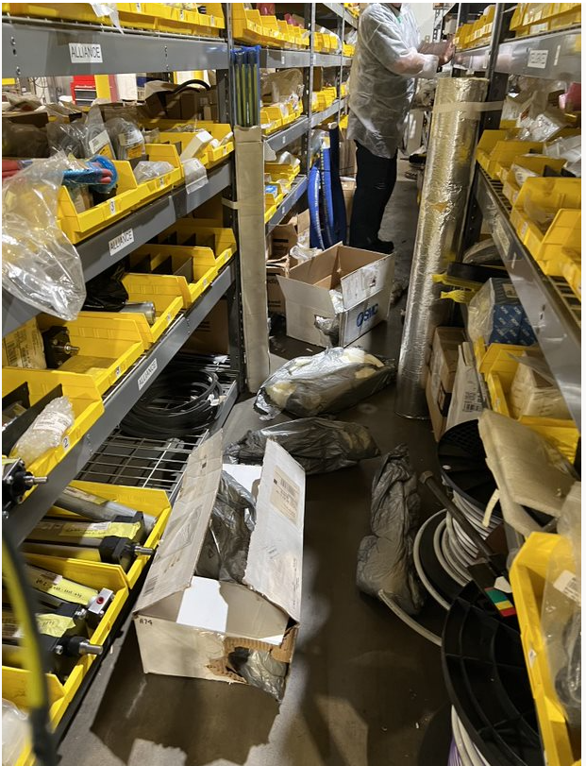
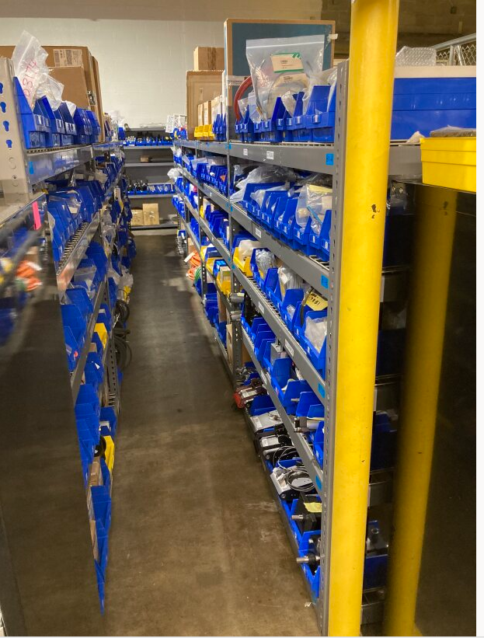
MRO Storeroom Optimization Case Study
10
Case Study - Storeroom Reconfiguration

Slide 19
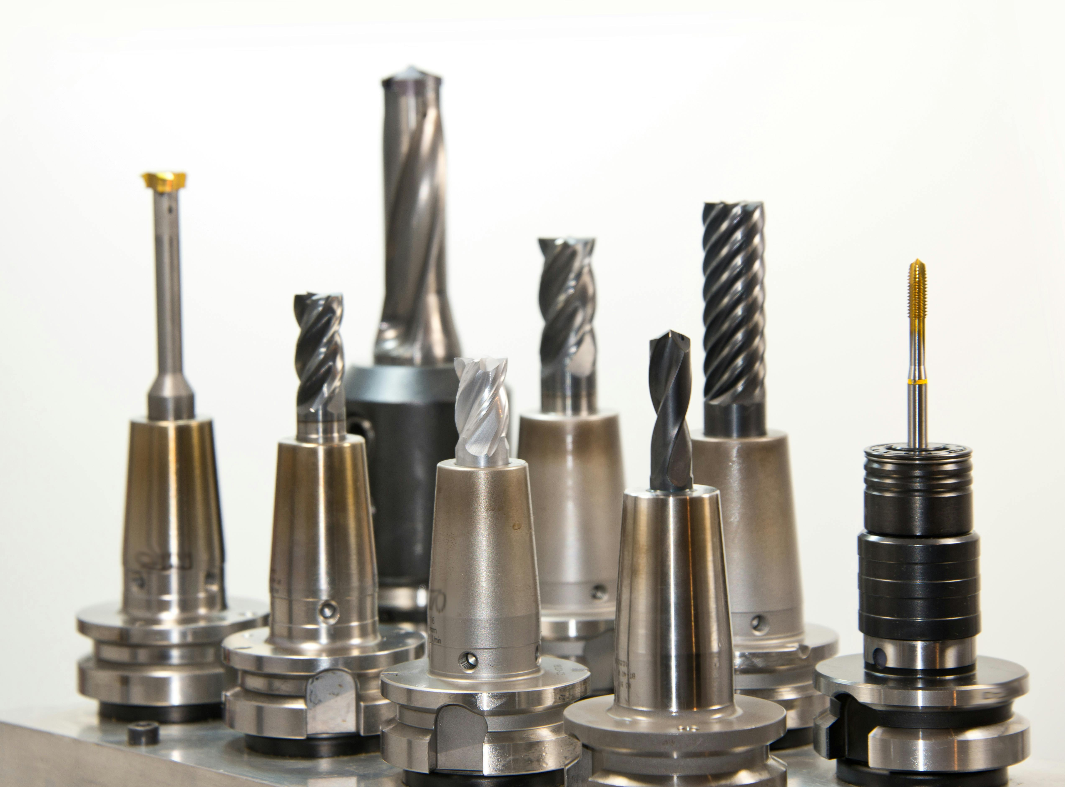
Storeroom Secrets
Use All Of Your Secrets To Drive Profitability & Performance & Make Your Storeroom an Operational Advantage
1
MRO Is A Critical Component of the Asset Lifecycle Management Process
6
Determine the Ingredients For Success
2
It’s Not Just A Storeroom Clerk
7
Your Data Is The Secret Sauce
3
Drive Success By Looking Beyond the Physical Storeroom
8
Define Your Process, Policy, & Execution Procedures
4
Analyze the Symptoms To Find Underlying Systematic Causes
9
Establish the Business Value & Measure Results
5
Determine Unique Organizational MRO Needs & Process Development Requirements
10
The Proof Is In the Pudding

